Slide 1

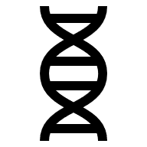
School of Computer Science and Engineering
Department of Computer Science and Engineering
Cura AI
Submitted By : Arnav Pawar
2427030272
Section K
Supervised By : Dr. Susheela Vishnoi

Slide 2
Index
Introduction
Problem Statement
Comparative Study
Literature Review
Proposed Solution
Proposed Tech Stack
Project Plan
Objectives
Current Progress
Frontend Screenshots
Future Applications
References

Slide 3
Introduction
A medical chatbot is an AI-based virtual assistant that engages users in natural language
conversations about their health-related questions. It operates 24/7 and provides accurate
and safe information.
Healthcare is a vital part of society, and with growing digitization, people increasingly turn to
the internet for medical guidance. However, online information is often unreliable, overly
complex, or misleading, which can confuse patients and lead to poor decisions.
Another major issue is that patients often cannot recall key symptom details—such as when
they started, how long they lasted, or their severity. This memory gap can hinder accurate
diagnosis and waste valuable consultation time.

Slide 4
Problem Statement
Finding dependable health information online is often an overwhelming battle against myths and unverified claims, which creates significant anxiety for individuals.
During a doctor's visit, patients struggle to recall precise symptom details like intensity or timing, leading to frustrating and inefficient consultations.
After an appointment, patients may receive reports filled with complex medical terms, leaving them feeling isolated and powerless in their healthcare journey.
This persistent gap between needing and understanding health information undermines patient confidence and creates a significant barrier to achieving better health.

Slide 5
Literature Review
Existing Systems:
Key Technologies:
Commercial Chatbots (Ada[5], WebMD[4]): Advanced, complex systems for symptom analysis, often proprietary.
Natural Language Processing (NLP): To understand user queries and identify key terms (symptoms, duration).
Research Prototypes: Academic projects that prove ML/NLP effectiveness for specific diseases.
Machine Learning Models: To map symptoms to conditions and provide relevant information.

Slide 6
Comparative Study
Feature | Ada | WebMD | Babylon | MS Health Bot | Cura AI (Proposed)
Conversational Chat | Yes | No | Yes | Yes | Yes
Basic Remedies | Limited | No | Yes | No | Yes
Report Explanation | No | No | No | No | Yes
Symptom Tracking | No | No | No | No | Yes
Reminder System | No | No | No | No | Yes

Slide 7




Proposed Solution
User Query:
User asks a question in plain language.
NLP Processing:
The system understands user intent (remedy, log, info) and extracts key terms
(e.g., "headache").
Action:
Remedy: ML model suggests a safe remedy (not medicine).
Tracking: Symptom is logged securely.
Report Scan: Extracts data and ML flags abnormal values.
Response:
A clear, simple answer is given to the user.

Slide 8
The strategy is a scalable web application:
• User Interface (UI): Chat interface that is responsive and clean where the users can chat with the bot.
• Backend (API): API is a minimal API written in Flask (Python) API. It takes the text of the user and transmits it to the NLP/ML module and employs the database to locate the correct answer.
• ML/NLP Components: The API is going to utilize spaCy as NLP and Scikit-learn as intent classification. Pytesseract will be used to extract text in the images of the medical reports.
• Database (MySQL): A manual repository of valid data, along with user information (symptom logs, medicine reminders), application of which is necessary to provide the response.

Slide 9
Proposed Tech Stack
Frontend (User Interface)
React.js: A JavaScript library used to build a responsive, and interactive user interface.
Backend (Server & Logic)
Flask (Python): A lightweight web framework used to create a powerful API. This API will serve as the brain of the application, connecting the frontend to the database and machine learning models.
Database (Data Storage)
MySQL: A reliable and widely-used relational database to securely store all essential data, including user profiles, symptom logs, and chat history.
ML & NLP Libraries (Python)
Scikit-learn: For building the core machine learning models that will map user-reported symptoms to relevant health information and safe remedies.
spaCy: For advanced Natural Language Processing (NLP) to accurately understand user queries, identify user intent, and extract key entities like "headache" or "fever" from sentences.
Pytesseract (OCR): To extract text from uploaded images of medical reports, allowing the system to analyze the data within them.

Slide 10
Project Plan
Semester - 3
• Problem Identification/Planning: Full literature review, comparative study of the existing tools and finalising the approach of a problem.
Semester - 4
• Prototype and UI Build the chat UI, configure the Flask API, develop the database, and train the first SVM intent classifier.
Semester - 5
• Develop MySQL database and spaCy NER model. Advanced Training and Report Analysis (OCR) -Increase the knowledge base, retrains the models using a larger dataset to improve accuracy.
Semester - 6
• Implement the final user-centric features: the symptom logging module (with data visualization) and the medicine reminder system. Add a directory of local hospitals/doctors. Conduct extensive user testing to find bugs and get feedback. Refine the UI/UX based on feedback. Finalize all documentation.

Slide 11
Objectives
01
02
Understand Queries
Provide Information
Develop an NLP module to accurately understand
user health questions.
Build an ML model to suggest safe remedies
and verified health information.
03
04
Track Symptoms
Simplify Reports
Implement a secure feature for logging symptom
history.
Design a prototype to analyze medical reports
and simplify results.

Slide 12
Current Progress
Literature review.
Comparative study of the existing tools.
Finalised the approach to the problem.
Developed basic prototype
Learning ML: Libraries like NumPy, MatPlotLib and Pandas, Scikit-learn, Pytesseract and SpaCy.
AI/ML concepts like supervised/unsupervised learning, NLP, Neural Networks, etc.

Slide 13
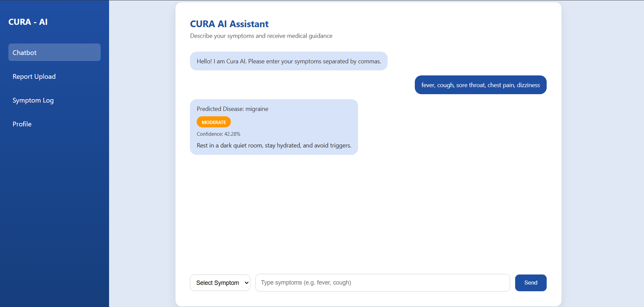

Slide 14
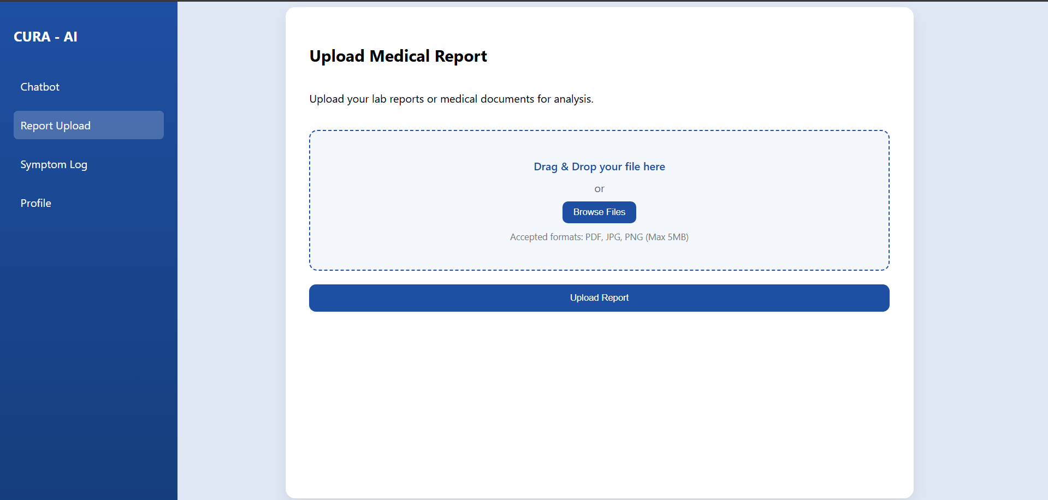

Slide 15
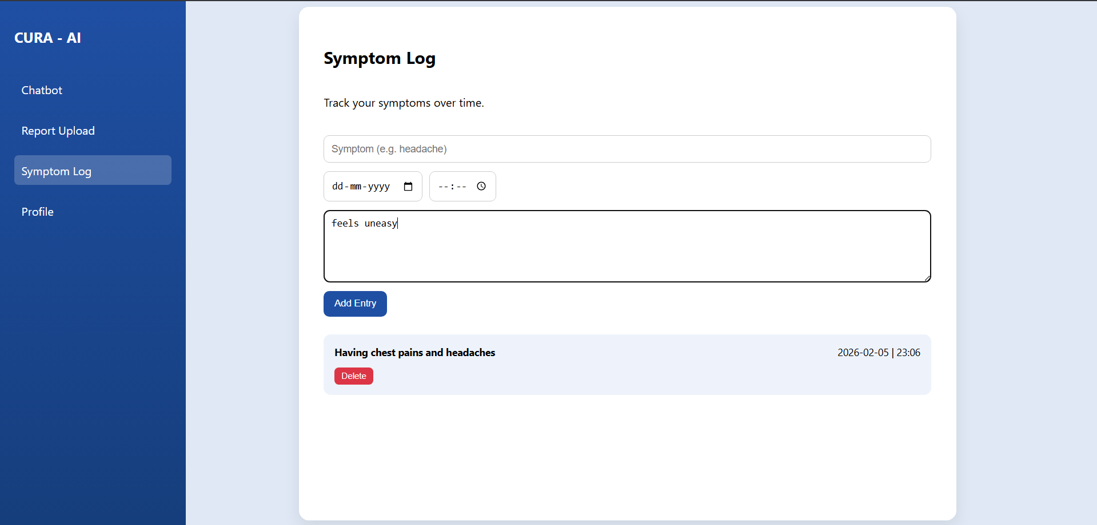

Slide 16
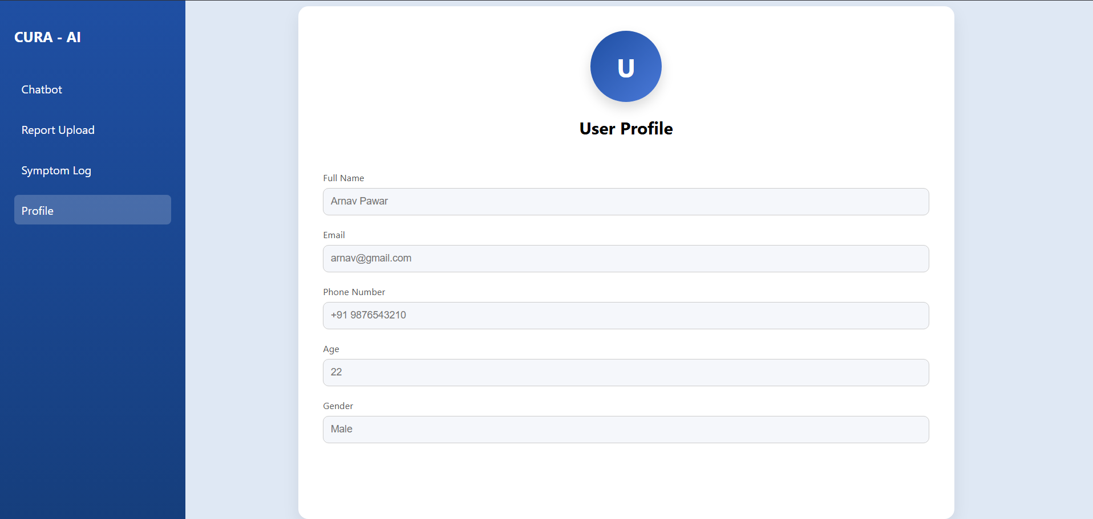

Slide 17

Future Applications
Expanded Report Analysis: Analyze more report types (urine, scans) and provide summaries.
Medication Reminders: Help users stick to their prescription schedules.
Mental Health Support: Offer initial support and resources for mental distress.
Appointment Booking: Integrate with clinics to assist with scheduling.
Location: Use location to find nearby hospital/doctor details.

Slide 18
References
[1] L. Athota, et al., "Chatbot for healthcare system using artificial intelligence," in 2020 8th International Conference on Reliability, Infocom Technologies and Optimization (ICRITO), 2020.
[2] P. Amiri and C. Sik Lanyi, "A review of the applications of chatbots in medicine," Informatics for Health and Social Care, vol. 47, no. 4, pp. 461-474, 2022.
[3] World Health Organization, "World Health Organization," [Online]. Available: https://www.who.int.
[4] WebMD, "WebMD," [Online]. Available: https://www.webmd.com.
[5] Ada Health. Available: https://ada.com

Slide 19
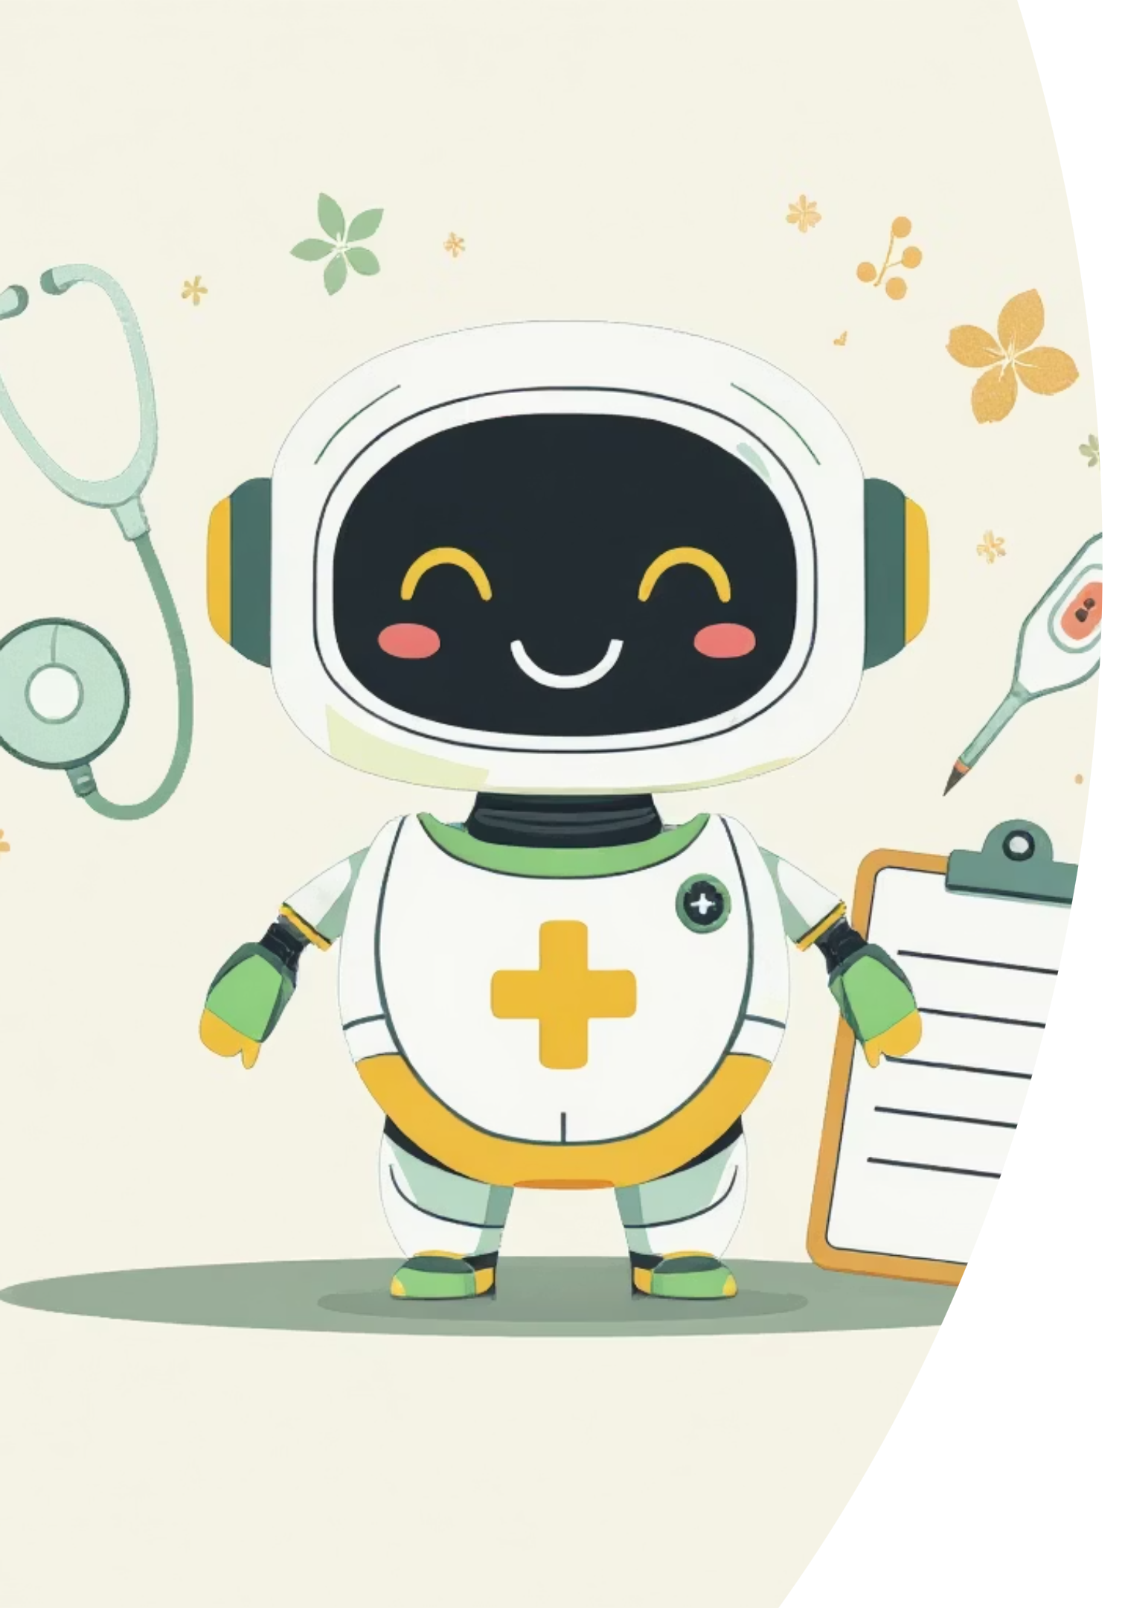
Thank You

